Slide 1
Lab3: Histogram Processing
CSE 4118 : Computer Vision and Image Processing Laboratory
Kazi Saeed Alam, Assistant Professor, Dept of CSE, KUET
email: saeed.alam@cse.kuet.ac.bd

Slide 2
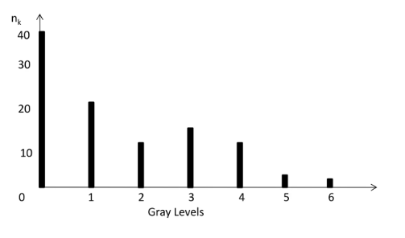

Histogram
The histogram of an image consists of the x-axis representing the intensity levels r_{k} and the y-axis denoting the h(r_{k}) or the p(r_{k}) functions.
$h(r_{k})=n_{k}$

Slide 3
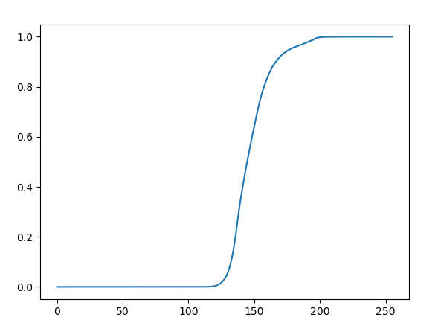
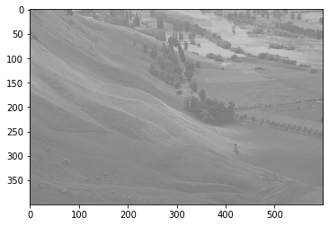
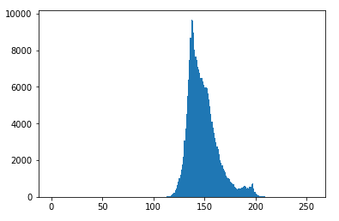
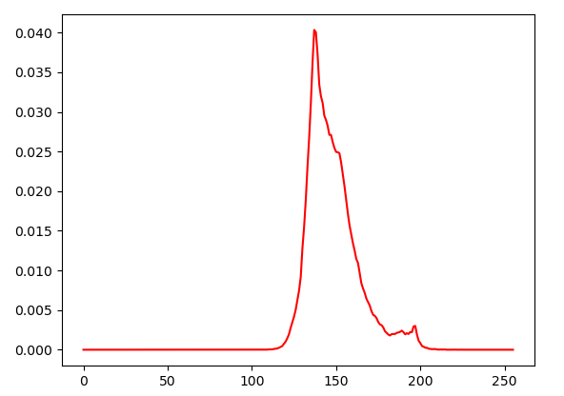
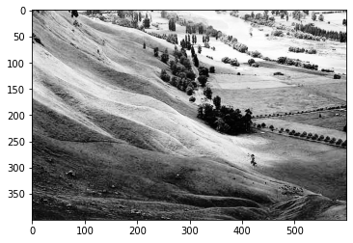
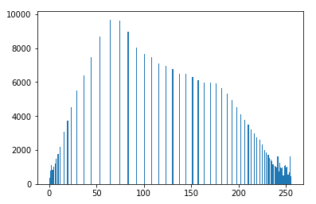
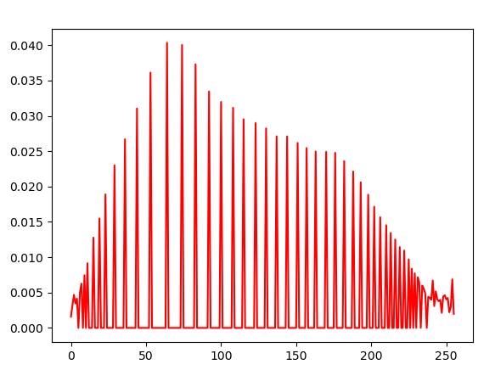
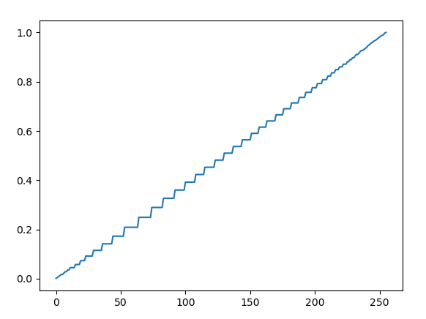
Histogram Equalization
Histogram equalization is used to enhance contrast.
Input Image
Histogram of the Input Image
PDF of the Input Image
CDF of the Input Image
Equalized Image
Histogram of the Equalized Image
PDF of the Equalized Image
CDF of the Equalized Image

Slide 4
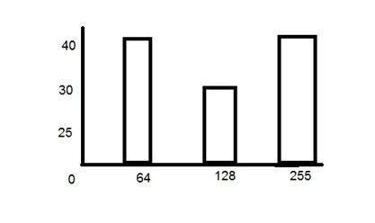
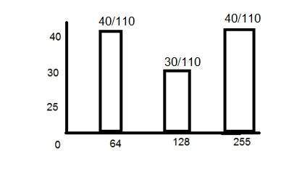


PDF
PDF stands for probability density function. It's a function where you can think of the x values as the range of possible occurring values and y values as their probability of occurrence.
$p\left(r_{k}\right)=\frac{n_{k}}{MN}$ $k=0,1,2……L−1$ $$n_{k}\text{: }\text{the} \text{number} \text{of} \text{pixels} \text{in} \text{the} \text{image} \text{of} \text{size} \text{M}×\text{N} \text{with} \text{intensity} r_{k}$$
$$n_{k}$$
PDF

Slide 5
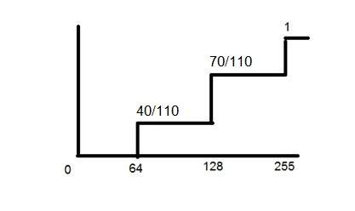
CDF
CDF holds the probability of a probability distribution less than or equal to a particular value.
It is a function that calculates the cumulative sum of all the values that are calculated by PDF.
PDF
CDF

Slide 6
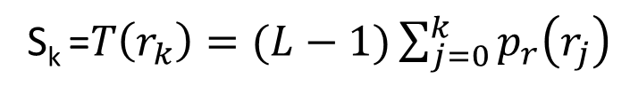
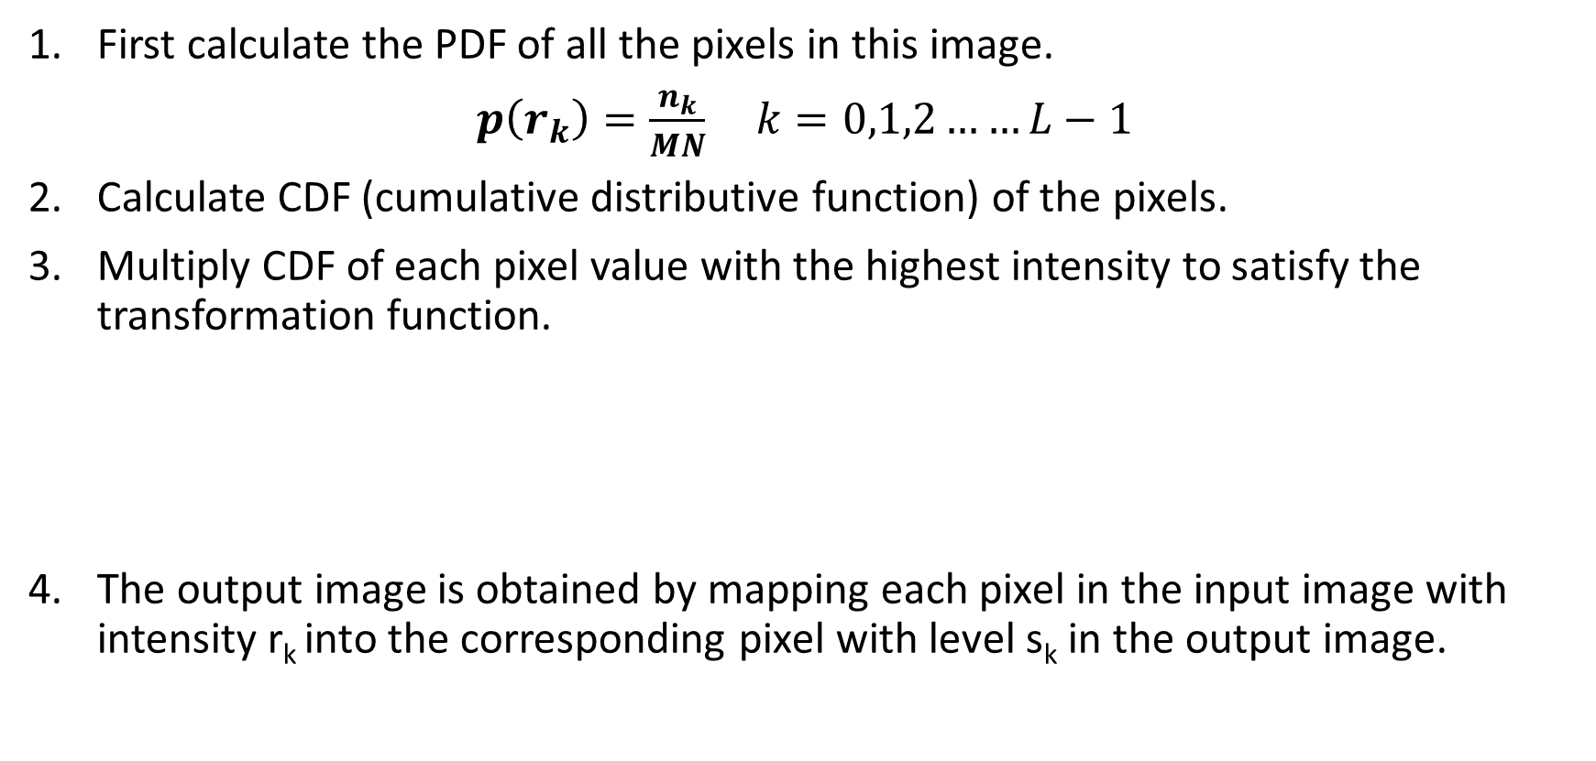
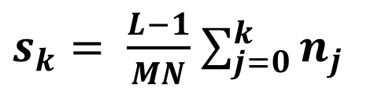
Histogram Equalization
First calculate the PDF of all the pixels in this image.
$p\left(r_{k}\right)=\frac{n_{k}}{MN}$ $k=0,1,2……L−1$
Calculate CDF (cumulative distributive function) of the pixels.
Multiply CDF of each pixel value with the highest intensity to satisfy the transformation function.
The output image is obtained by mapping each pixel in the input image with intensity r_{k} into the corresponding pixel with level s_{k} in the output image.
S_{k} =$T\left(r_{k}\right)=(L−1)\sum_{j=0}^{k}{p_{r}\left(r_{j}\right)}$
$s_{k}= \frac{L−1}{MN}$ $\sum_{j=0}^{k}{n_{j}}$

Slide 7
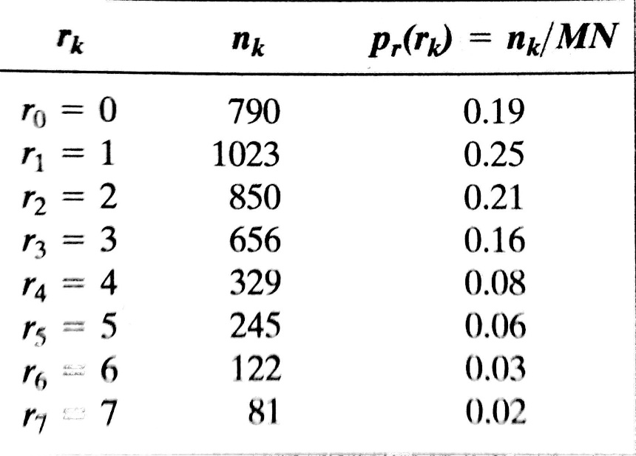
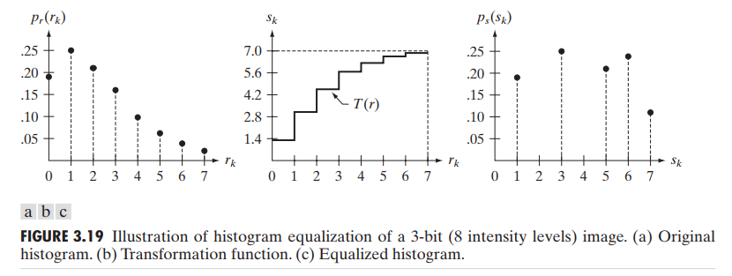
Map s_{k} to its r_{k}
s_{k}
S₀ = 1.33 = 1
S₁ = 3.08 = 3
S₂ = 4.55 = 5
S₃ = 5.67 = 6
S₄ = 6.23 = 6
S₅ = 6.65 = 7
S₆ = 6.86 = 7
S₇ = 7.00 = 7

Slide 8
Classwork
Take an input color image and apply histogram equalization to enhance contrast.
For the RGB image, apply histogram equalization to each of the 3 channels separately. Merge the 3 channels to view the enhanced image.
Convert the RGB image to the HSV image and apply histogram equalization only in the Value channel. Merge the new equalized value channel with the other two to generate the final output equalized image.
Show the histogram of input and the equalized image

Slide 9
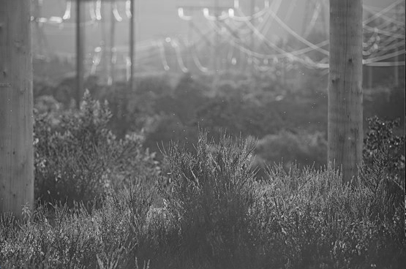
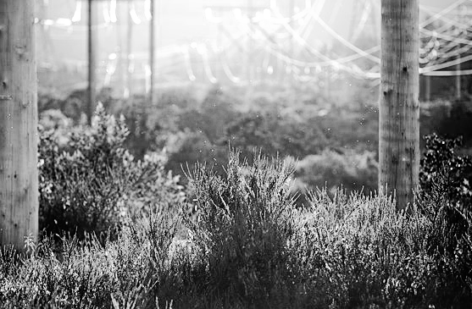
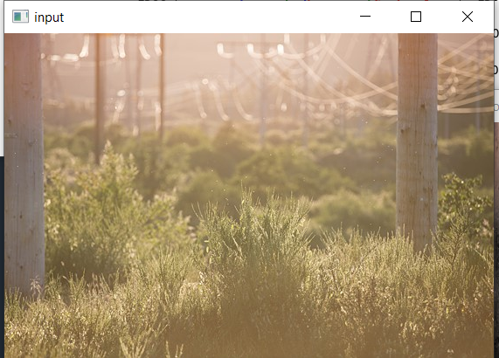
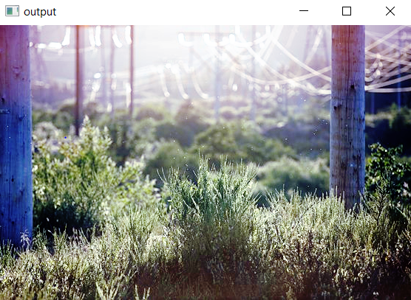
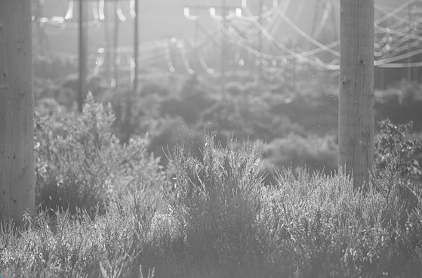
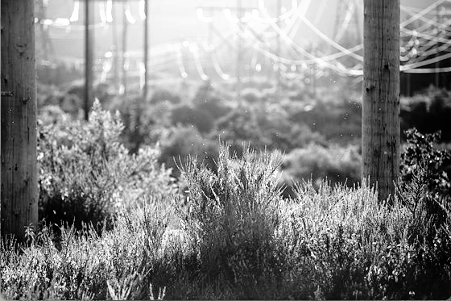
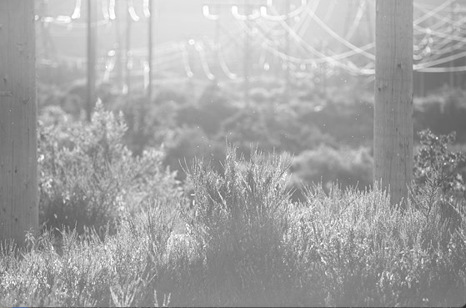
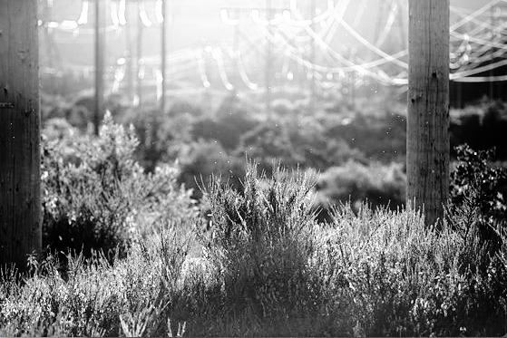
Classwork
Green Channel
Equalization
Equalization
Blue Channel
Input
Equalization
Output
Red Channel

Slide 10
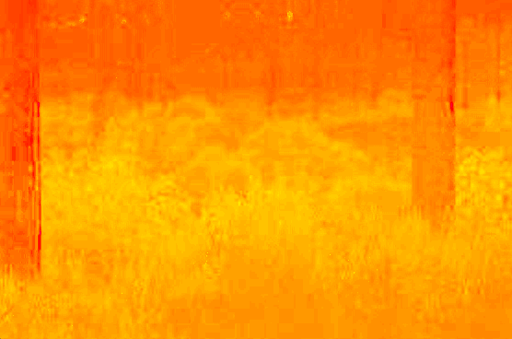
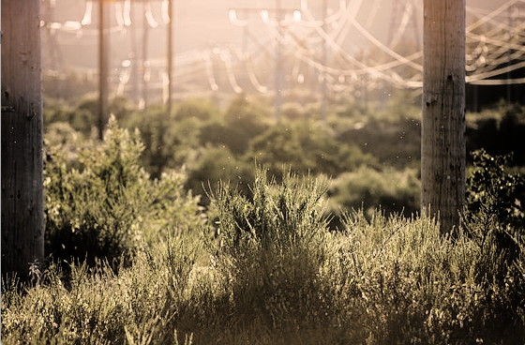
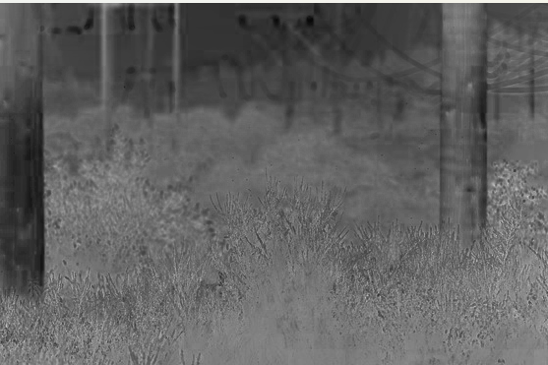

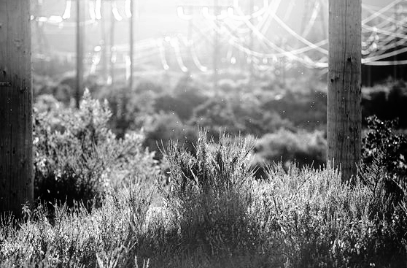
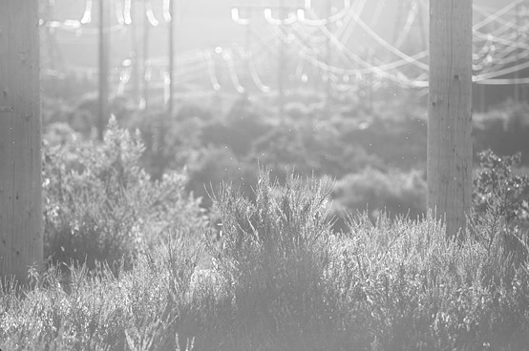
Classwork
Hue channel
Saturation channel
Output
Input
Equalization
Value channel

